Slide 1
Decision tree implementation
Dr. Kavita. S. Oza

Slide 2
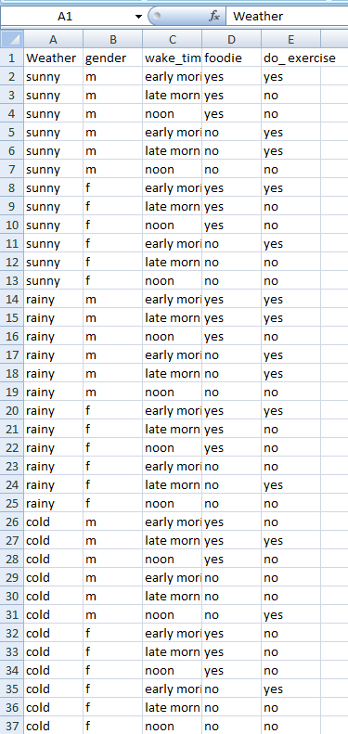
Data set
Weather
Sunny, Rainy, Cold
Gender
Male (m) Female(f)
Wake up time
Early morning
Late morning
Noon
Foodie
Yes, No
do_ exercise
Yes, No

Slide 3
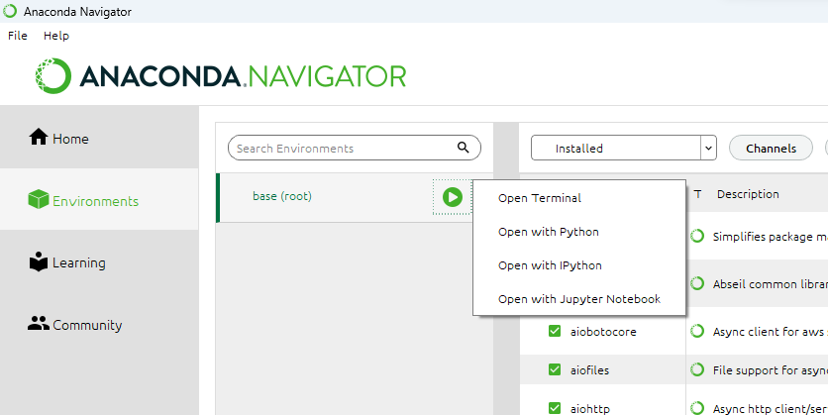
Installing Graphviz

Slide 4
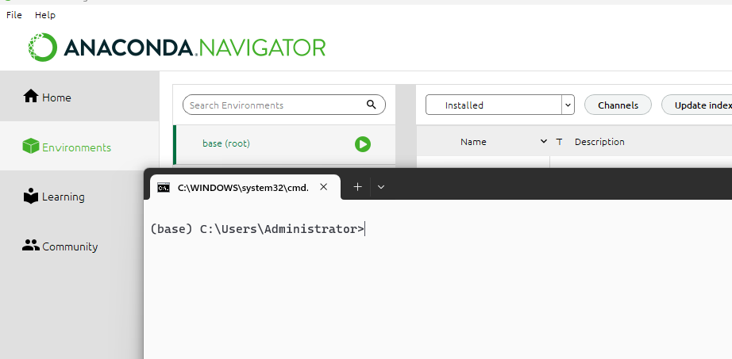
Installing Graphviz…

Slide 5
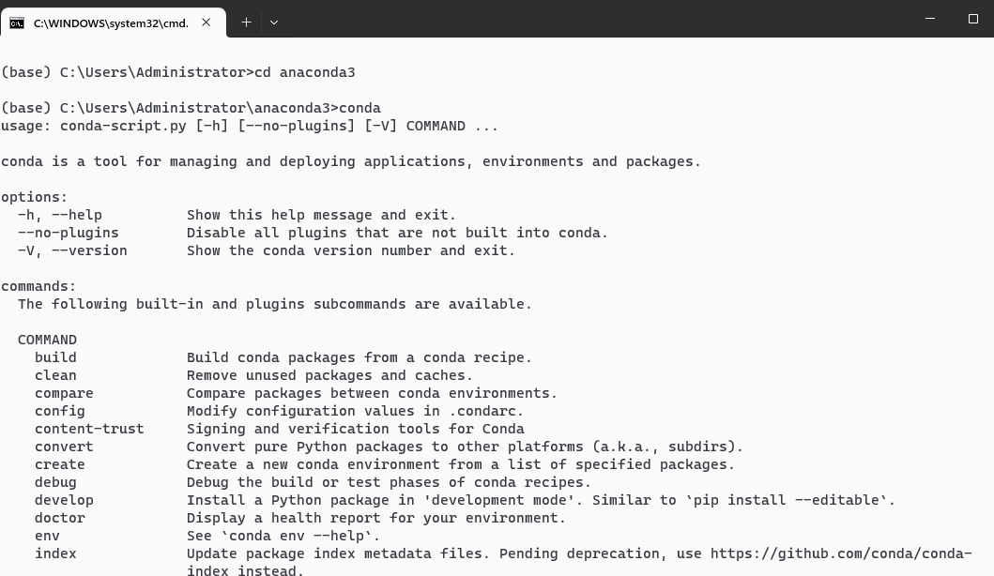
Check where anaconda folder exist
Go to anaconda folder by using cd command
Type conda

Slide 6
Install Graphviz
(base) c:\users\Administrator\anaconda3> conda install python-graphviz

Slide 7
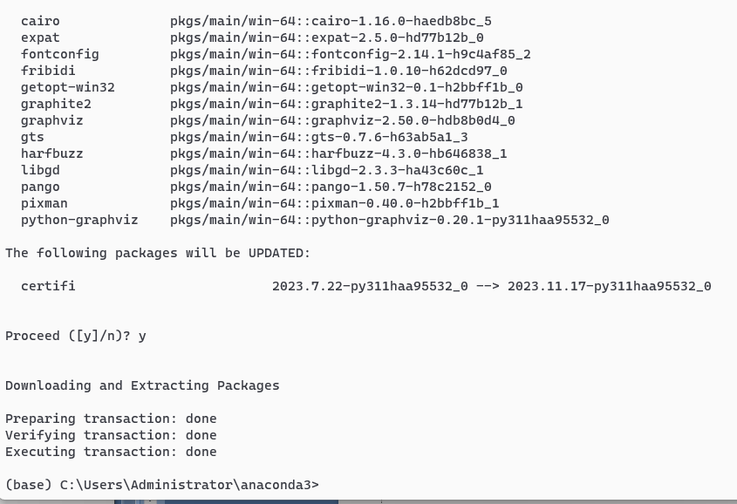
Type ‘y’ to proceed

Slide 8
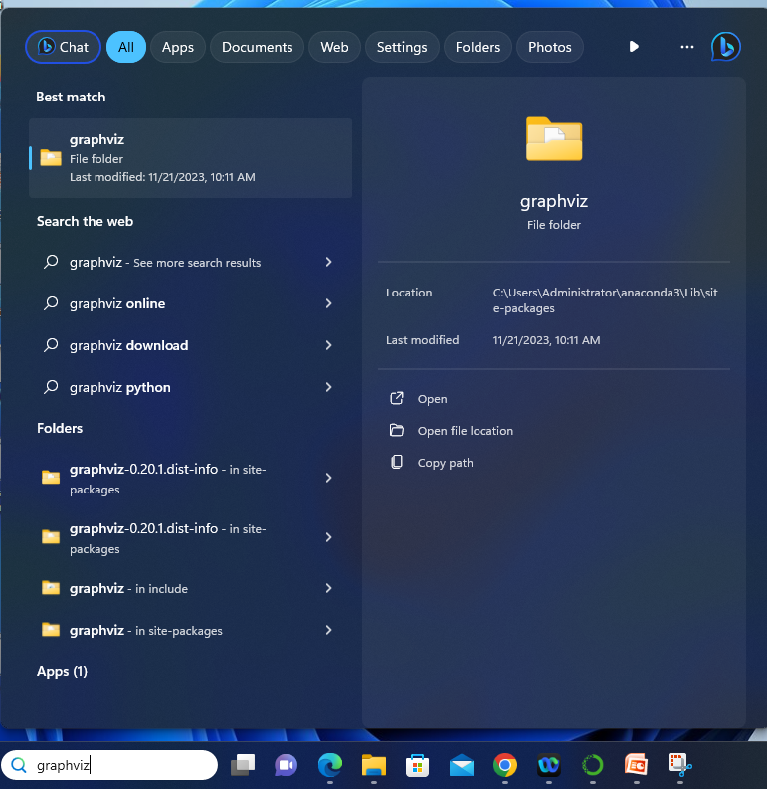
Search for graphviz folder on your PC
C:\Users\Administrator\anaconda3\Lib\site-packages\graphviz

Slide 9
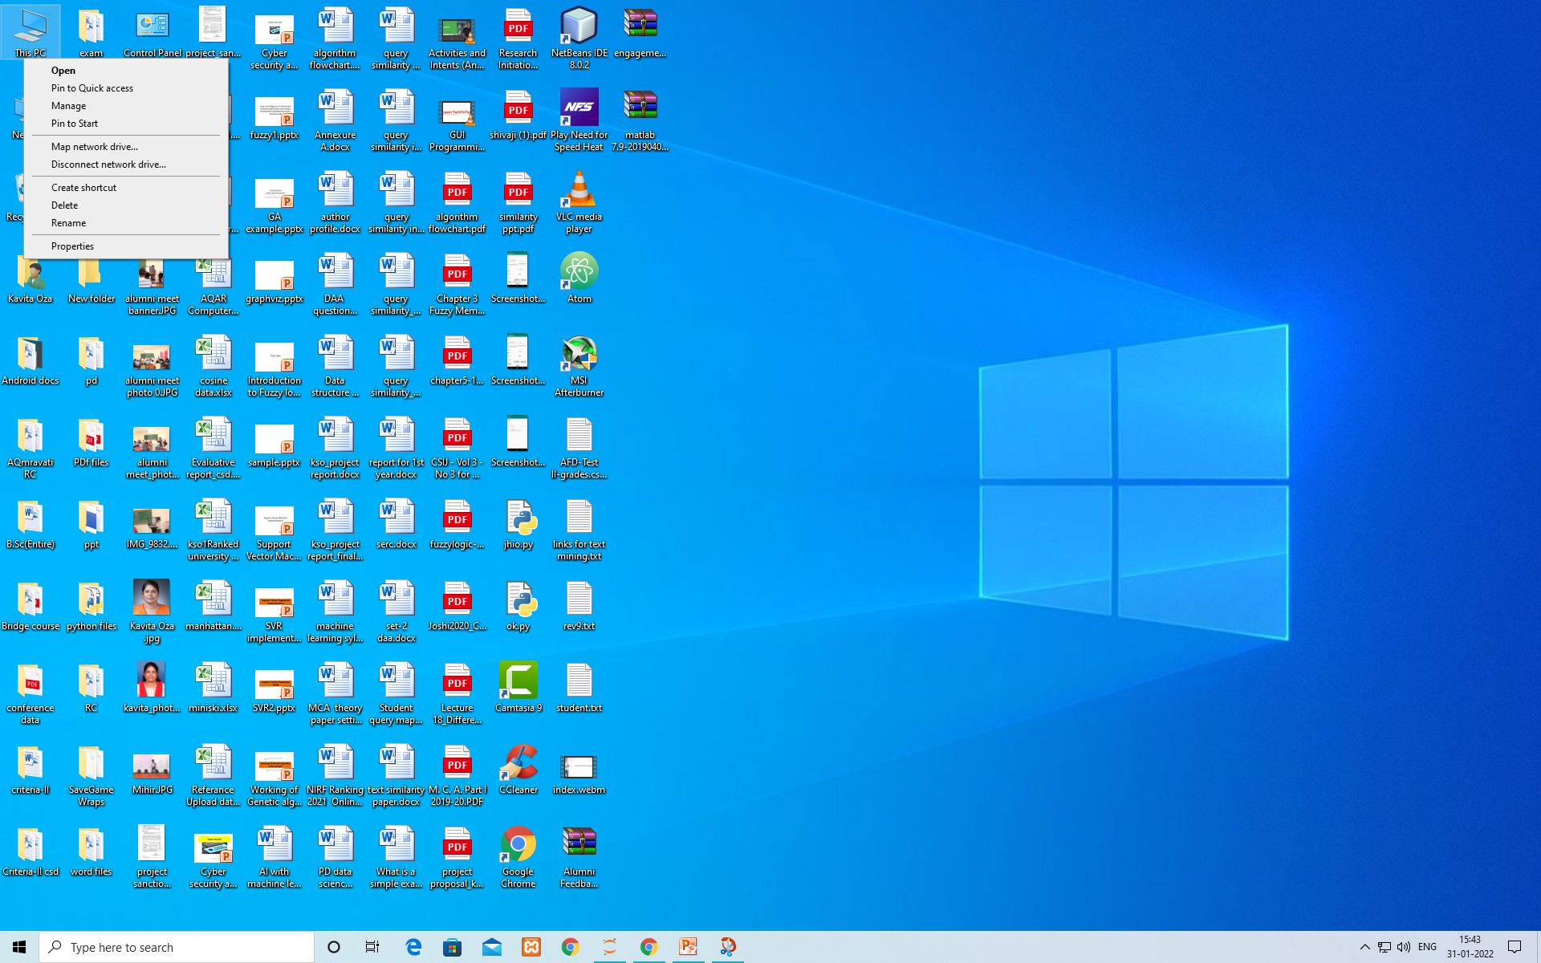
Adding Graphviz to path variable
Click on properties

Slide 10
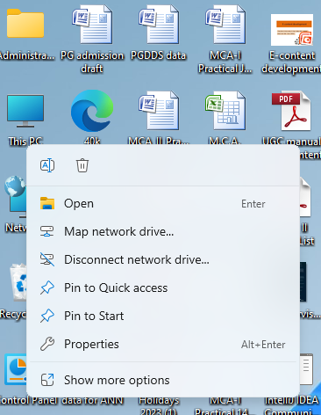
This PC→ Properties
Right click on This PC

Slide 11
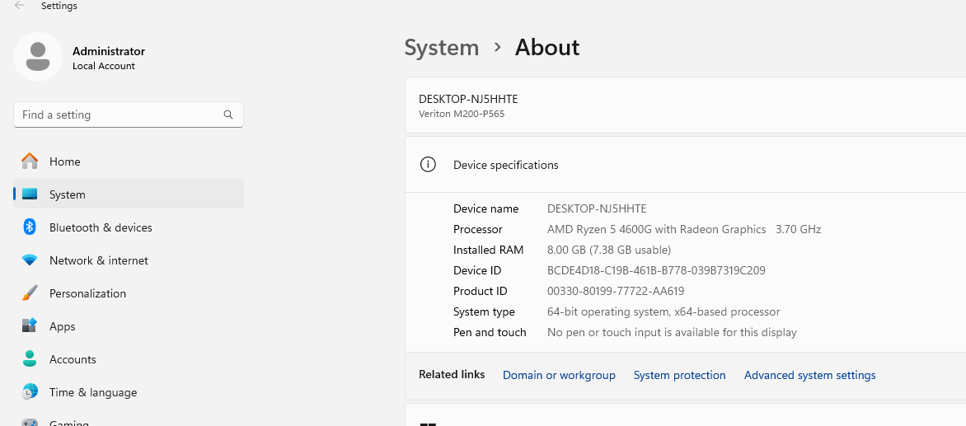
Click on Advanced system settings

Slide 12
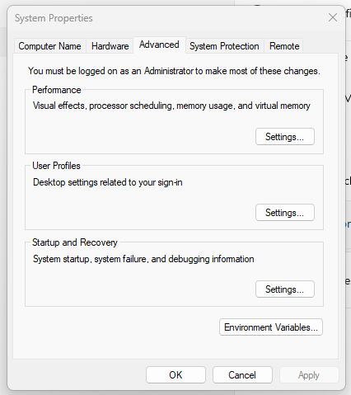
Click on Environment Variables…

Slide 13
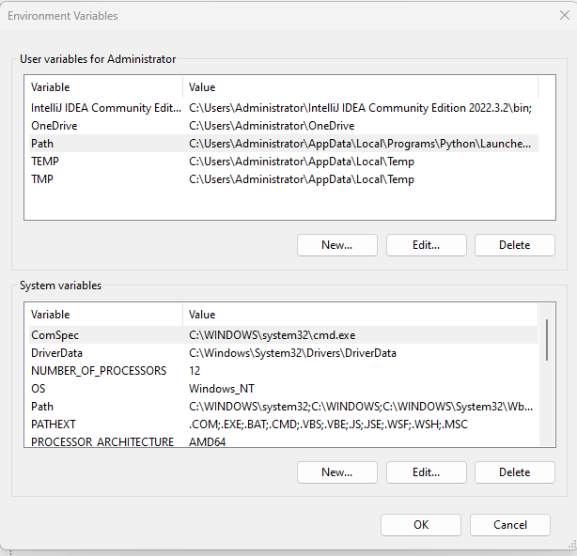
Select Path and click on Edit…

Slide 14
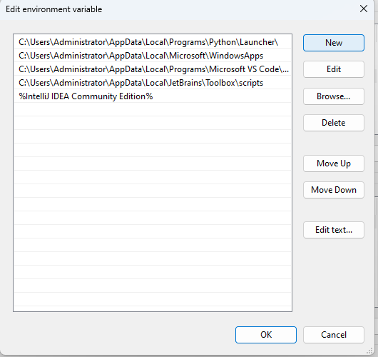
Click on New

Slide 15
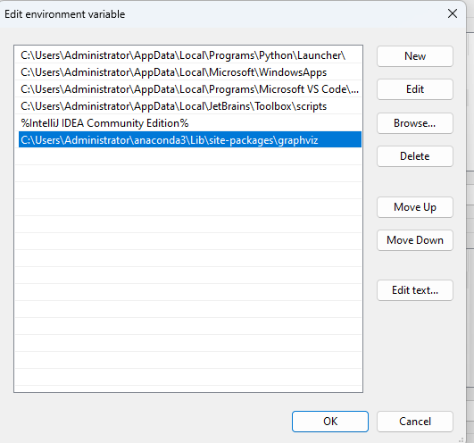
Add path to Graphviz folder
C:\Users\Administrator\anaconda3\Lib\site-packages\graphviz

Slide 16
Adding path to environment variable
Right click on This PC (my Computer)→ select properties→Advanced system settings→
Environment variable→path→ edit → new →paste (C:\Users\Administrator\anaconda3\Lib\site-packages\graphviz) →press ok

Slide 17
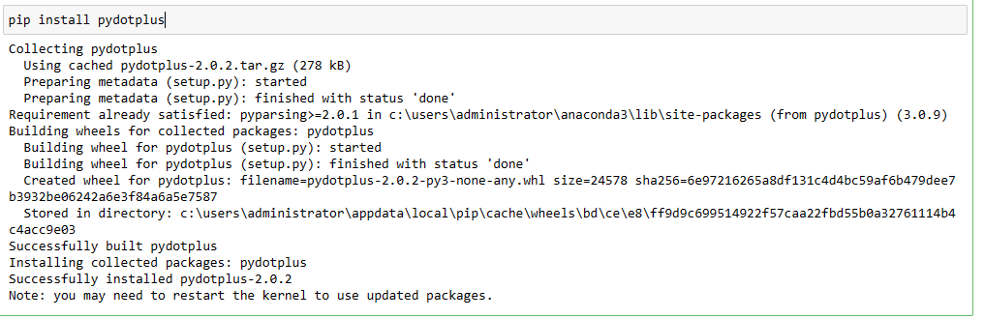
Installing pydotplus
pip install pydotplus
pip is the preferred installer program, allows packages to be installed for use by a particular application, rather than being installed system wide.
pydotplus module provides a full interface to create handle modify and process graphs in Graphviz’s dot language.

Slide 18
Importing Libraries
import numpy as np
import pandas as pd
# Import train_test_split
from sklearn.model_selection import train_test_split
# Import Decision Tree Classifier
from sklearn.tree import DecisionTreeClassifier
#Import scikit-learn metrics module for accuracy compute
from sklearn.metrics import accuracy_score

Slide 19
Importing Libraries…
import matplotlib.pyplot as plt
import seaborn as sns
from sklearn.metrics import classification_report, confusion_matrix

Slide 20
Libraries for Visualizing tree
import six
import sys
sys.modules['sklearn.externals.six'] = six
from sklearn.tree import export_graphviz
from IPython.display import Image
import pydotplus
Six is a Python 2 and 3 compatibility library. It provides utility functions for smoothing over the differences between the Python versions with the goal of writing Python code that is compatible on both Python versions.

Slide 21
Reading and mapping data
df=pd.read_csv('D:\\kso\\PGDDS\\data.csv')
d={'sunny': 0, 'rainy': 1, 'cold':2}
e= { 'm':0, 'f': 1}
f= {'early morining':0, 'late morning':1, 'noon':2}
g= {'yes':0,'no':1}
h= {'yes':0,'no':1}
df['Weather'] = df['Weather'].map(d)
df['gender']=df['gender'].map(e)
df['wake_time']=df['wake_time'].map(f)
df['foodie']=df['foodie'].map(g)
df['do_ exercise']=df['do_ exercise'].map(h)

Slide 22
Dataset info
df.info()
df.shape
df.isnull().any()

Slide 23
Separating features and class label
features = ['Weather', 'gender', 'wake_time', 'foodie']
X= df[features]
y = df['do_ exercise']
print(X)
print(y)

Slide 24
Training Decision tree
X_train, X_test, Y_train, Y_test = train_test_split(X, y, random_state=0)
# Import the model
from sklearn.tree import DecisionTreeClassifier
#Make an instance of the Model
clf = DecisionTreeClassifier(max_depth = 2, random_state = 0)
#Train the model on the data
clf.fit(X_train, Y_train)
#Predict labels of unseen (test) data
clf.predict(X_test)

Slide 25
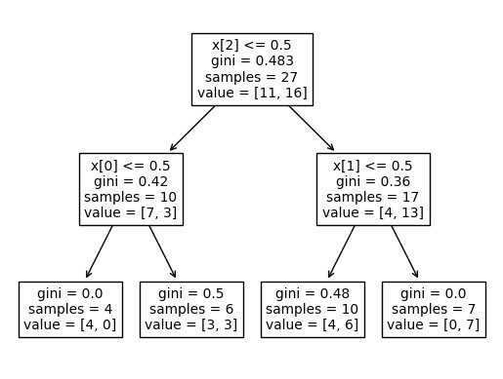
Plotting of tree
tree.plot_tree(clf);

Slide 26
Plotting of tree with labels
from sklearn.tree import plot_tree
fn = ['Weather', 'gender', 'wake_time', 'foodie']
cn=['yes', 'no']
dec_tree = plot_tree(decision_tree=clf, feature_names = fn, class_names =cn , filled = True , precision = 4, rounded = True)

Slide 27
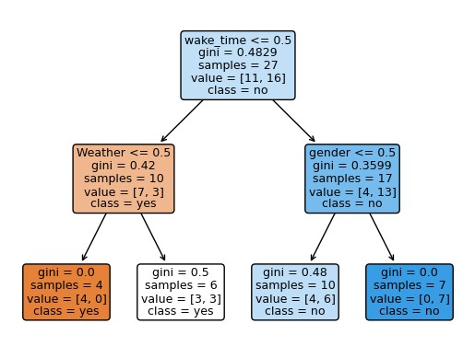
Plotting of tree with labels…

Slide 28
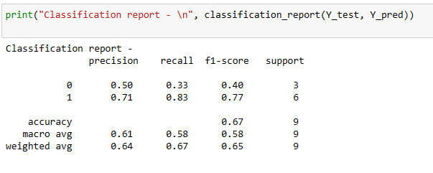
Accuracy of Model
from sklearn import metrics
Y_pred=clf.predict(X_test)
print("Accuracy:",metrics.accuracy_score(Y_test, Y_pred))
print("Classification report - \n", classification_report(Y_test, Y_pred))

Slide 29
Plotting Tree with graphviz
from six import StringIO
dot_data = StringIO()
export_graphviz(clf, out_file=dot_data,
filled=True, rounded=True,
special_characters=True)
graph = pydotplus.graph_from_dot_data(dot_data.getvalue())
graph.write_png('work.png')
Image(graph.create_png())

Slide 30
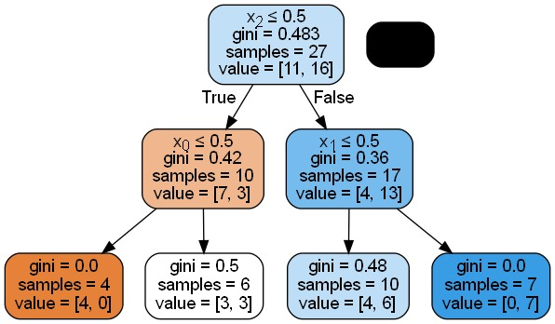
Plotting Tree with graphviz

Slide 31
Tree with labels
features=['Weather', 'gender', 'wake_time', 'foodie']
dot_data = StringIO()
export_graphviz(clf, out_file=dot_data, filled=True, rounded=True,special_characters=True, feature_names = features, class_names=['yes','no'])
graph = pydotplus.graph_from_dot_data(dot_data.getvalue())
graph.write_png('work.png')
Image(graph.create_png())

Slide 32
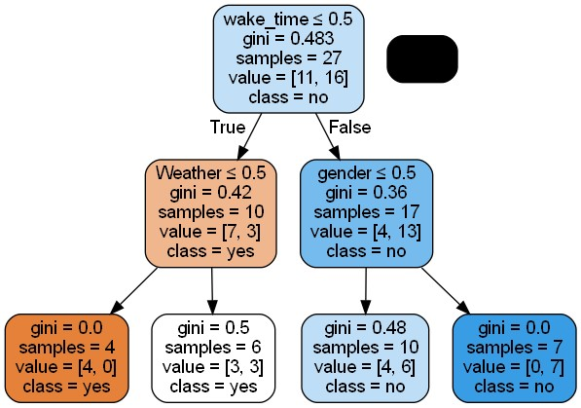
Tree with labels…

Slide 33
Visualise all attributes
# plot pair plot to visualise the attributes all at once
sns.pairplot(data=df, hue = 'do_ exercise')
The Seaborn Pairplot allows to plot pairwise relationships between variables within a dataset. pairs plot allows to see both the distribution of single variables and relationships between two variables in a dataset. This creates a visualisation and helps to understand the data by summarising a large amount of data in a single figure. This is essential when exploring dataset and trying to become familiar with it.

Slide 34
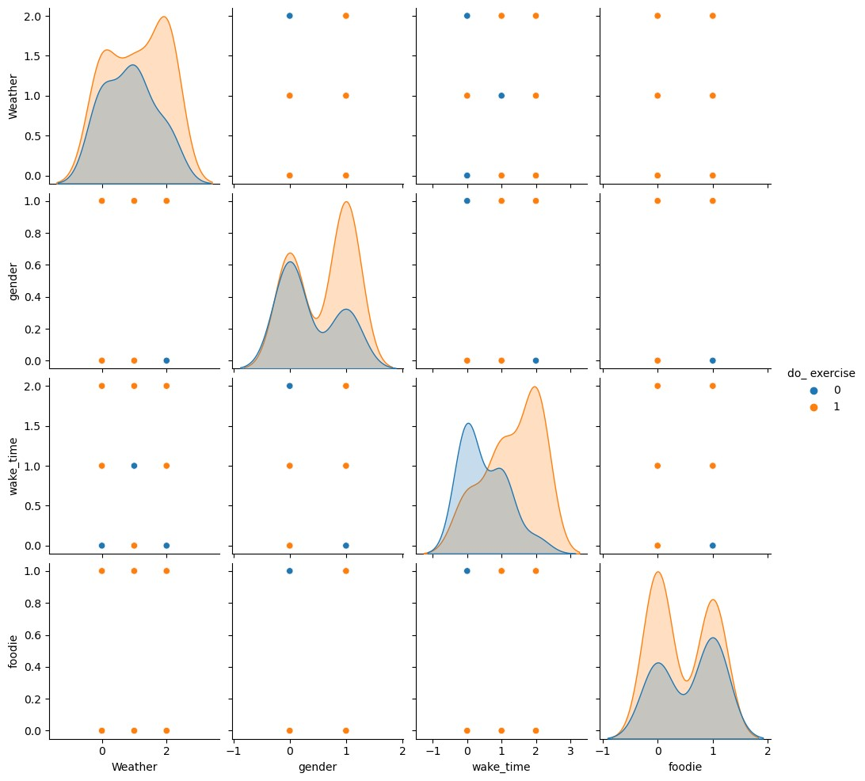
Pair plot

Slide 35
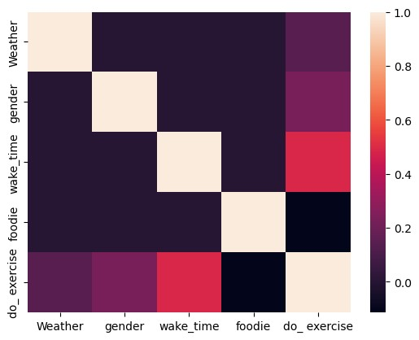
Correlation matrix
# correlation matrix
sns.heatmap(df.corr())
A correlation heatmap is a graphical tool that displays the correlation between multiple variables as a color-coded matrix.
It’s like a color chart that shows how closely related different variables are.
In a correlation heatmap, each variable is represented by a row and a column, and the cells show the correlation between them.
The color of each cell represents the strength and direction of the correlation, with darker colors indicating stronger correlations.

Slide 36
Confusion matrix
cm = confusion_matrix(Y_test, Y_pred)
plt.figure(figsize=(5,5))
sns.heatmap(data=cm,linewidths=.5, annot=True,square = True, cmap = 'Blues')
plt.ylabel('Actual label')
plt.xlabel('Predicted label')
all_sample_title = 'Accuracy Score: {0}'.format(clf.score(X_test, Y_test))
plt.title(all_sample_title, size = 10)

Slide 37
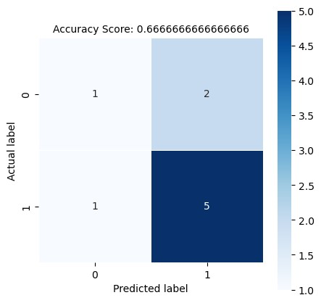
Confusion matrix

Slide 38
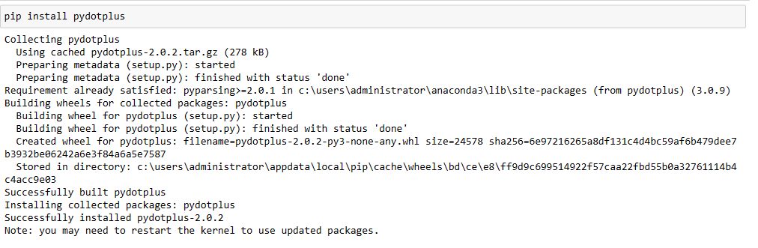
Program at a glance

Slide 39
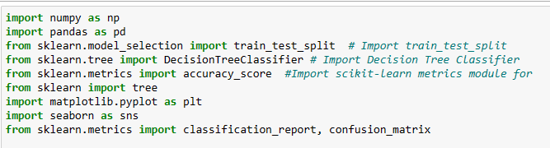
Program at a glance…

Slide 40
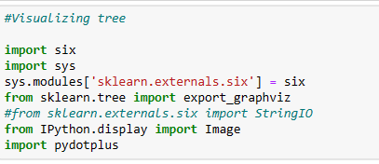
Program at a glance

Slide 41
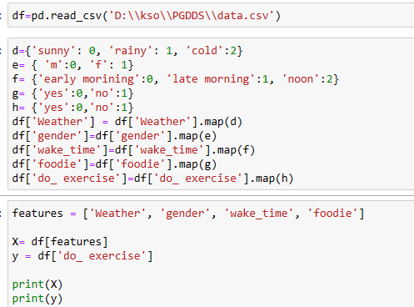
Program at a glance

Slide 42
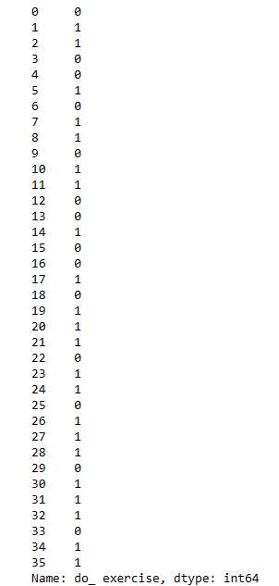
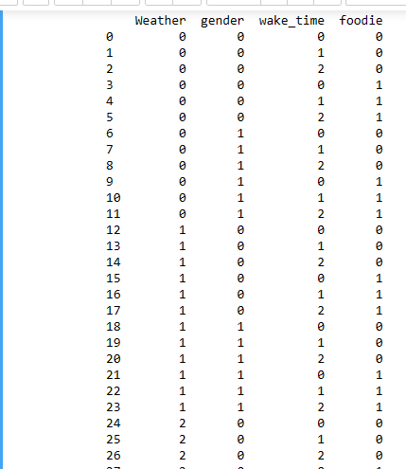
Program at a glance

Slide 43
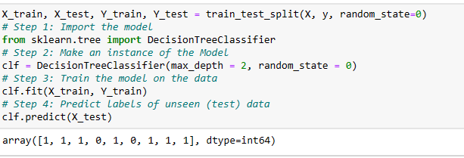
Program at a glance

Slide 44
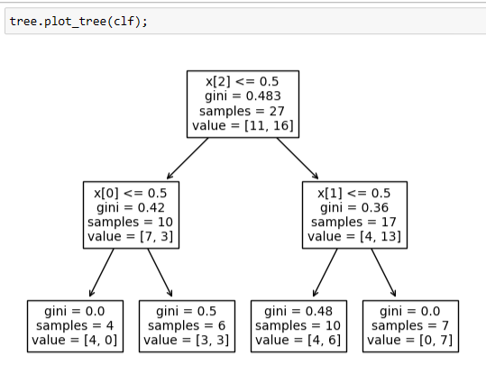
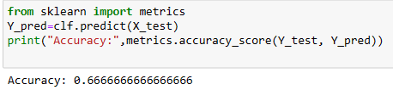
Program at a glance

Slide 45
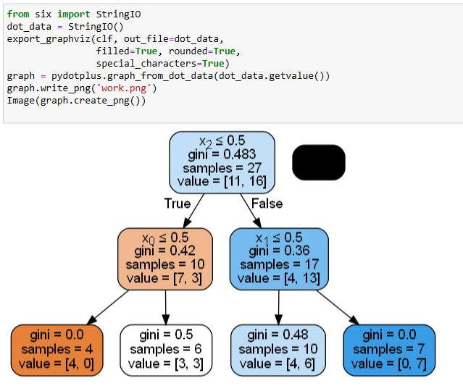
Program at a glance

Slide 46
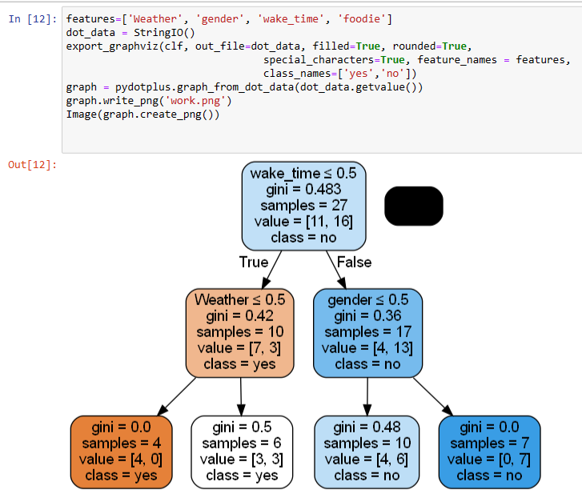
Program at a glance

Slide 47
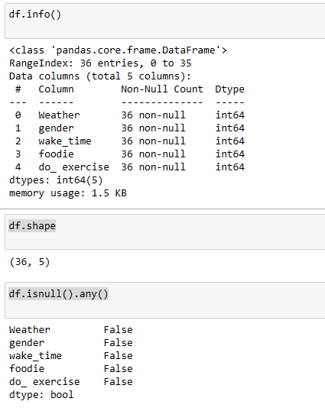
Program at a glance

Slide 48
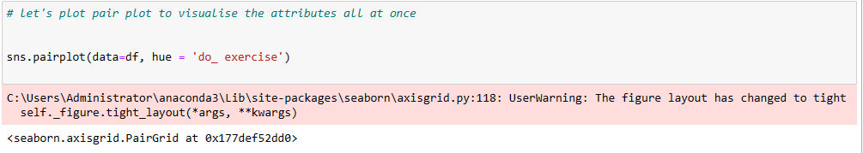
Program at a glance

Slide 49
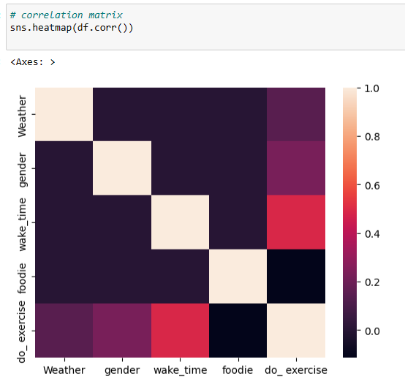
Program at a glance

Slide 50
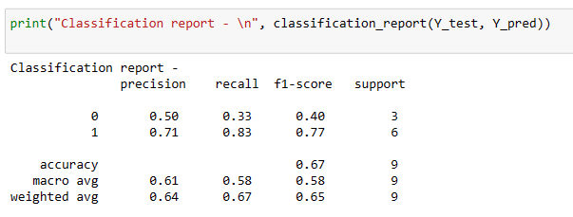
Program at a glance

Slide 51
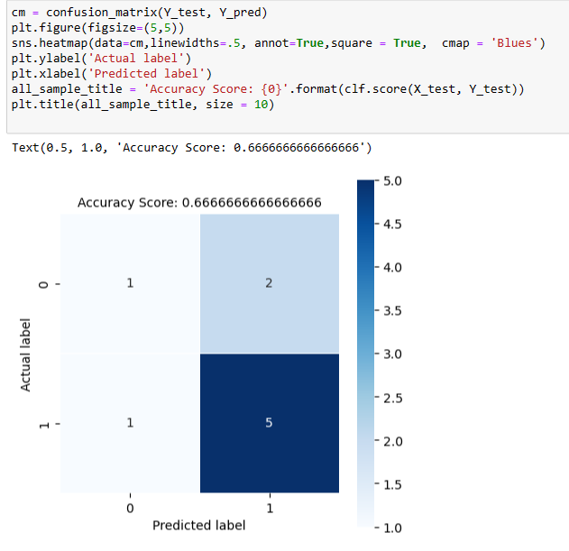
Program at a glance

Slide 52
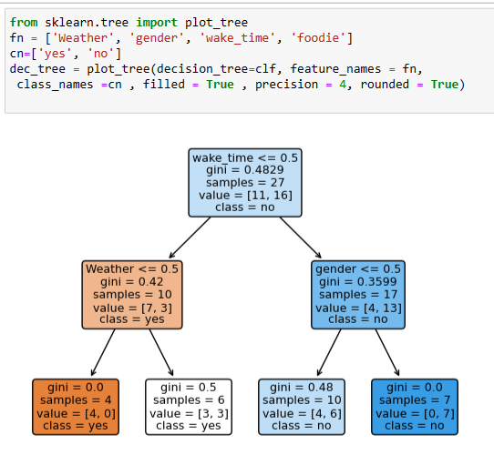
Program at a glance

Slide 53
Thank You

